Slide 1
Biden drops out of the presidential race
Understanding Biden’s decision to drop out and what’s next for the Democratic nomination
July 22, 2024
PRODUCERS
Eamonn Howerter & Sam Bowles

Slide 2
Biden drops out of the race following intense political and public pressure
I believe it is in the best interest of my party and the country for me to stand down and to focus solely on fulfilling my duties as President for the remainder of my term.
– President Joe Biden, July 21, 2024
AGE AND ELECTORAL VIABILITY CONCERNS
“Given his performance in the debate, which of these do you think Biden should do?”
Ipsos Poll, July 5-9, 2024, 2431 respondents, +/- 2.1%
of Americans who want Biden to step aside cited his age, health or cognitive function as their biggest concern
– YouGov Poll
73%
of registered voters believe Biden is not mentally fit to serve as President
- CBS/YouGov Poll
72%
SOURCE NY Times, Axios, Ipsos.
PRESENTATION CENTER 7/22/24
Notes:
Sources:
Rebecca Falconer, “Biden says he's "not going anywhere" as calls for him to step aside grow,” Axios, July 5, 2024, https://www.axios.com/2024/07/05/biden-democratic-donors-finance-disney-heiress
Mia McCarthy, “Another battleground Dem calls on Biden to withdraw,” POLITICO, July 12, 2024, https://www.politico.com/live-updates/2024/07/12/congress/19th-dem-calls-on-biden-to-drop-out-00167847
Jacob Kutson, “Poll: 67% of Americans say Biden should bow out of presidential race,” Axios, July 11, 2024, Poll: 67% of Americans say Biden should bow out of presidential race
Kathy Frankovic, “Trump's lead, Biden's age, Harris, Vance, and conventions: July 13 - 16, 2024 Economist/YouGov Poll,” YouGov, July 17, 2024, https://today.yougov.com/politics/articles/50102-trump-lead-biden-age-harris-vance-conventions-july-13-16-2024-economist-yougov-poll
Ana Faguy, Allies defend Biden as poll suggest growing age concern,” BBC, June 30, 2024, https://www.bbc.com/news/articles/crgln3jx47go

Slide 3
Polls showed voters trusted Trump’s handling of the economy over Biden’s
Importance and trust in handling issues
ABC/Washington Post/Ipsos poll, July 12, 2024
■ Biden ■ Trump
Trump + 10
Trump + 14
Biden + 6
Biden + 13
Biden + 1
Trump + 11
Trump + 9
Trump + 7
Trump vs Biden approval ratings
SOURCE ABC, Ipsos, Washington Post, Gallup.
PRESENTATION CENTER 7/22/24
Notes:
Sources:
https://www.langerresearch.com/wp-content/uploads/1233a2TrumpsNomination.pdf

Slide 4
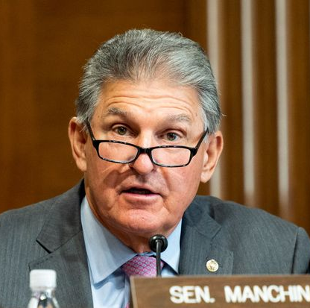
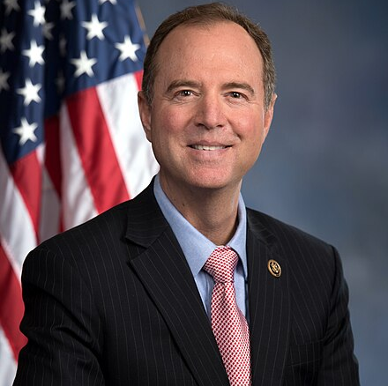
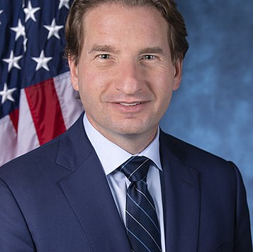
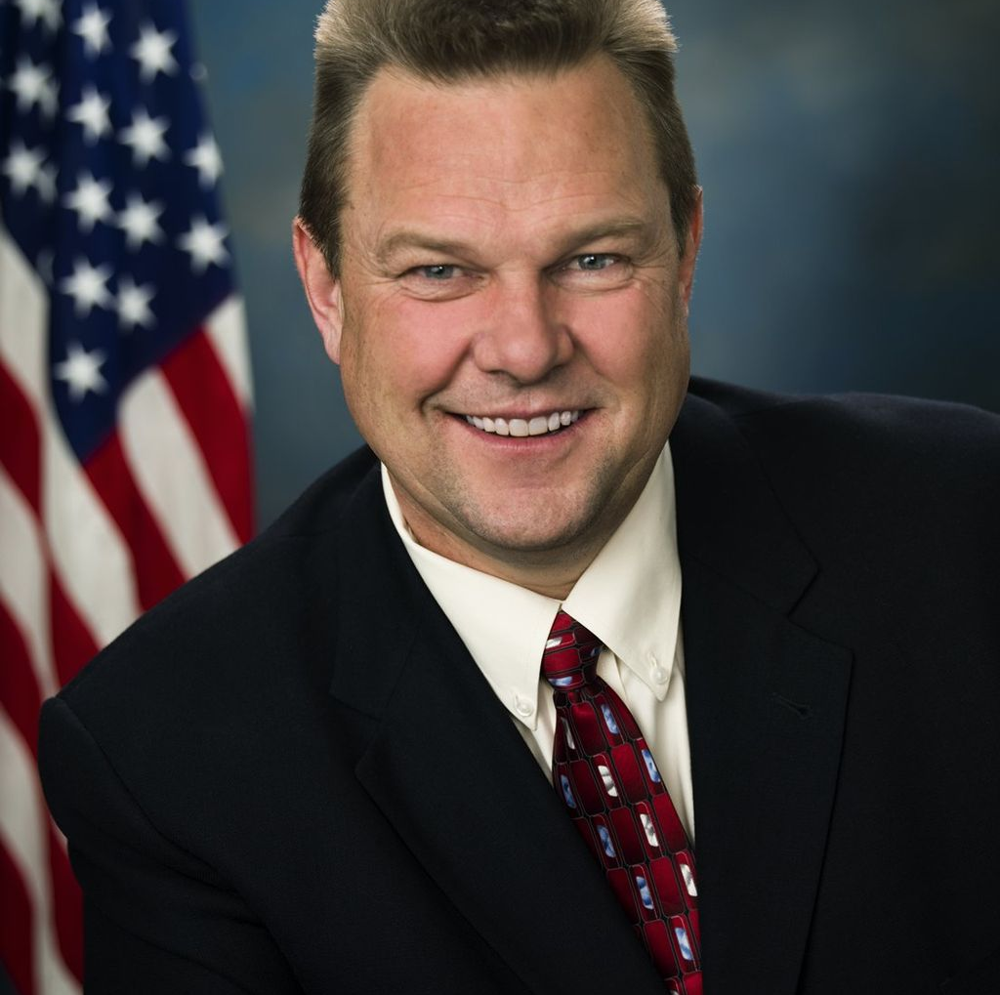
Concern from congressional Democrats and party leaders thrust the Biden campaign into crisis
CALLS TO STEP DOWN
Sen. Manchin (I-WV)
Rep. Schiff (D-CA-30)
"So, with that, I come with a heavy heart to think the time has come for him to pass the torch to a new generation.”
It would be “better for the Democratic party, and better for the country if [Biden] were to bow out.”
40 members of Congress
Rep. Phillips (D-MN-03)
Sen. Tester (D-MT)
“Appears the president remains unaware … of the ominous public polling, tanking approval numbers, and dire sentiment sweeping the country.”
"While I appreciate his commitment to public service and our country, I believe President Biden should not seek re-election to another term."
4
Senators
36
Representatives
Although top Democrats did not publicly move to oust Biden, they communicated party discontent
Senate Majority Leader Chuck Schumer (D-NY) met with Biden privately on July 13, urging him to “think about” dropping out of the race
Former Speaker of the House Nancy Pelosi (D-CA) urged Democrats to “speak their conscience” and focus on preserving their seat in Congress
House Minority Leader Hakeem Jeffries (D-NY) expressed concern to Biden that the president would hurt the party’s chances in the November elections
Biden’s advisors spent the day before the announcement discussing his grim path to victory, eventually helping him draft his statement stepping down
SOURCE The Guardian, ABC News, BBC, WSJ.
PRESENTATION CENTER 7/22/24
Notes:
Sources:
Edward Helmore, “Dean Phillips calls on Democrats to hold ‘immediate vote of confidence’ on Biden,” The Guardian, July 21, 2024, https://www.theguardian.com/us-news/article/2024/jul/21/dean-phillips-democrats-biden-immediate-vote-of-confidence#:~:text=Phillips%20told%20the%20station%20he,the%20opportunity%20to%20step%20aside.
Ana Faguy, “Biden under new pressure from top Democrats as Covid halts campaign,” BBC, July 18, 2024, https://www.bbc.com/news/articles/cv2gj8314nqo
Ivan Pereira, “These Democrats called for Joe Biden to drop out of 2024 race before his announcement,” ABC News, July 21, 2024, https://abcnews.go.com/Politics/democrats-who-have-called-on-joe-biden-step-down/story?id=111854551
Zeke Miller, Prominent Democrat Schiff calls for Biden to withdraw, but party aims to nominate before convention,” AP News, July 17, 2024, https://apnews.com/article/biden-democrats-debate-convention-virtual-ac84492b500ab3fd972076b592113e5a
Lindsay Wise, “How Schumer Worked Behind the Scenes,” WSJ, July 21, 2024, https://www.wsj.com/livecoverage/biden-drops-out-election-2024/card/how-schumer-worked-behind-the-scenes-ClDm2OboJnQhgioQouiW
Dean Phillips, “Democrats should hold a no-confidence vote on Biden,” WSJ, July 21, 2024, https://www.wsj.com/articles/democratic-lawmakers-need-a-confidence-vote-on-biden-election-2024-e800806a
Scott Wong, “As Biden dug in on continuing his campaign, Nancy Pelosi kept the pressure on,” NBC News, July 22, 2024, https://www.nbcnews.com/politics/2024-election/nancy-pelosi-helped-pressure-joe-biden-end-2024-campaign-rcna162943
Alexandra Hutzier, “2024 election live updates: Manchin the latest to call on Biden to end reelection bid,” ABC News, July 21, 2024, https://abcnews.go.com/Politics/live-updates/debate-over-future-of-bidens-candidacy-continues-111818141?id=111816443&entryId=112127252
Catherine Lucey, “The Final Hours: How Biden Made His Decision to Drop Out,” WSJ, July 22, 2024, https://www.wsj.com/livecoverage/biden-drops-out-election-2024/card/the-final-hours-how-biden-made-his-decision-to-drop-out-FyZk31squ42q6DUc0nTK

Slide 5
The Biden administration achieved several major legislative successes over its four years
OVERVIEW
Led the country out of a devastating pandemic, increased domestic investment, and supported the tech sector
Appointed Justice Ketanji Brown Jackson to the Supreme Court, making her the first black woman to serve there
Inflation Reduction Act
Increased funding for the IRS, helping it crack down on tax evasion and close loopholes
Lowered Affordable Care Act Premiums
Appropriated $369 billion to energy production and climate change programs
Committed to reducing carbon emissions by 40% by 2030
CHIPS Act
Allocated over $75 billion to expanding US semiconductor manufacturing capabilities
Authorized $102 billion through 2027 for the National Science Foundation, Department of Commerce, and the National Institute of Standards and Technology
Infrastructure Investment and Jobs Act
Granted $550 billion to federal roads, bridges, internet, and other infrastructure projects
Expected to generate 1.4 million jobs from 2024-2025
Invested $50 billion in flood and drought protection in at-risk zones
SOURCE Senate Democrats, McKinsey, JEC.
PRESENTATION CENTER 7/22/24
Notes:
Sources:
“SUMMARY: THE INFLATION REDUCTION ACT OF 2022,” Senate Democrats, Accessed July 22, 2024, https://www.democrats.senate.gov/imo/media/doc/inflation_reduction_act_one_page_summary.pdf
“The CHIPS and Science Act: Here’s what’s in it,” McKinsey and Company, October 4, 2022, https://www.mckinsey.com/industries/public-sector/our-insights/the-chips-and-science-act-heres-whats-in-it
“UPDATED FACT SHEET: Bipartisan Infrastructure Investment and Jobs Act,” The White House, Accessed July 22, 2024, https://www.whitehouse.gov/briefing-room/statements-releases/2021/08/02/updated-fact-sheet-bipartisan-infrastructure-investment-and-jobs-act/
Don Beyer and Martin Heinrich, “The bipartisan Infrastructure Investment and Jobs Act will create jobs, strengthen the economy and reduce inflationary pressures,” Joint Economic Council, Accessed July 22, 2024, https://www.jec.senate.gov/public/_cache/files/d1342923-d8e8-4c82-b1ea-6818a9253e25/econ-benefits-of-bipartisan-infra-deal-fact-sheet.pdf
“The Senate Confirms Justice Ketanji Brown Jackson to serve on the US Supreme Court,” The White House, Accessed July 22,2 2024, https://www.whitehouse.gov/kbj/

Slide 6
What’s next for Kamala Harris
Presumed Democratic nominee
Fundraising efforts
I am honored to have the President’s endorsement and my intention is to earn and win this nomination. I will do everything in my power to unite the Democratic Party – and unite our nation – to defeat Donald Trump and his extreme Project 2025 agenda.”
– Kamala Harris accepts Joe Biden’s endorsement
Fundraising pours in for Harris’ campaign
In the first 24 hours after Biden announced he would no longer seek re-election, over $50M in donations came in to back Kamala Harris’ campaign against Trump
After fundraising slowed for the Biden campaign following his poor debate performance, Harris’ strong fundraising day will refill the campaign’s funds and she will likely inherit the remaining Biden campaign funds
Endorsements
Delegates pledging to Harris
Elected Democrats line up to endorse Harris
Over 150 congressional representatives have endorsed Kamala Harris’ presidential bid
38 senators have endorsed Harris’ presidential bid
18 Democratic governors have endorsed Kamala Harris
Most importantly, Joe Biden endorsed his running mate, though former President Obama did not when he addressed Biden’s withdrawal from the race
Harris en route to securing 1,986 delegates
Delegates in the Democratic presidential nomination process are free to vote for any candidate they choose following Biden dropping from the race
Harris will need to secure 1,986 delegates to become the Democratic nominee, and already has secured delegates from Florida, North Carolina, Pennsylvania, and more to garner over 500 as of July 22
SOURCE Washington Post, FOX News, The Hill, Trib Live.
PRESENTATION CENTER 7/22/24
Notes:
Sources:
https://www.washingtonpost.com/politics/interactive/2024/kamala-harris-endorsements/
https://thehill.com/homenews/campaign/4785260-vice-president-harris-delegates/
https://triblive.com/news/pennsylvania/pa-democratic-delegates-vote-to-support-kamala-harris-as-nominee/
https://www.ktvu.com/news/60-million-raised-kamala-harris-presidential-run

Slide 7
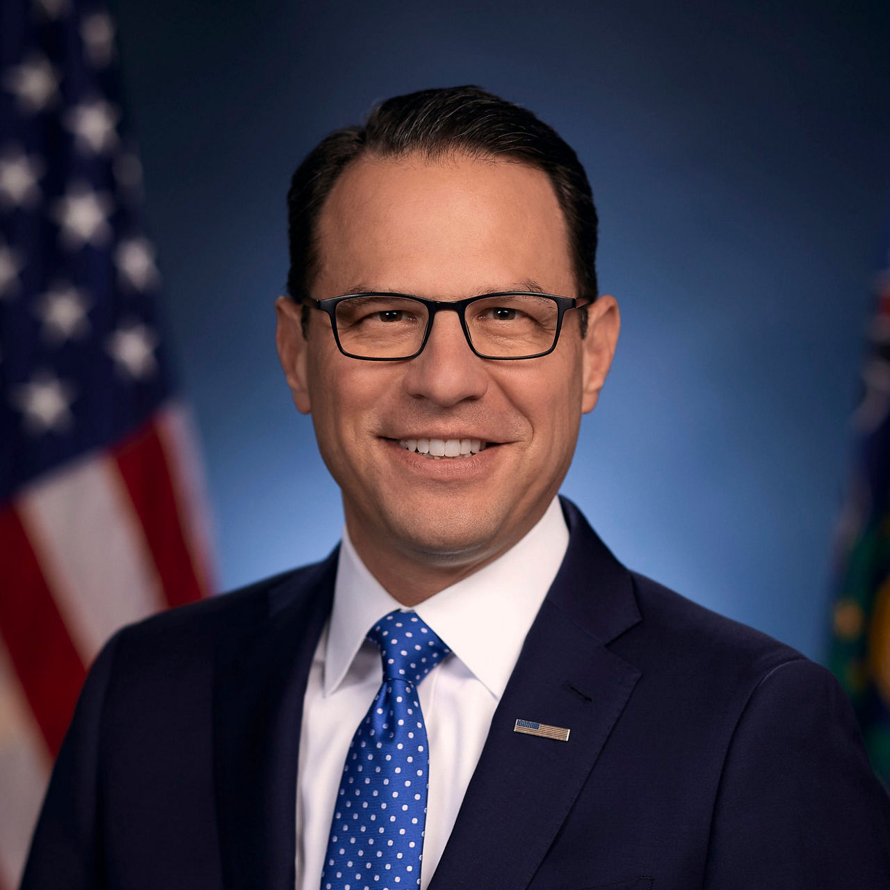
Red state and swing state governors top the shortlist for Harris’ VP options
Harris is likely to select a governor that can help her electoral odds should she be the Democratic nominee, though many names have been thrown around such as Govs. Gavin Newsom (D-CA), JB Pritzer (D-IL), Senators Mark Kelly (D-AZ) and Joe Manchin (I-WV), and Secretary of Transportation Pete Buttigieg
TOP CONTENDERS FOR HARRIS’ VP
Gov. Andy Beshear (D-KY)
Beshear has won two statewide elections in Kentucky, which has a strong Republican electorate, since 2019
Has been outspoken on funding for education and health care programs as governor; Beshear has endorsed Kamala Harris and supports Biden’s decision
Gov. Josh Shapiro (D-PA)
Former Attorney General who prioritized reducing violent crime
Pennsylvania is an important swing state in the 2024 election cycle, and Shapiro overwhelmingly won the gubernatorial election in 2022 (14+ points) and could help Harris in the electoral college
Gov. Roy Cooper (D-NC)
Longtime North Carolina lawmaker, former State Assembly member, and Attorney General
Biden came within 1.5% of winning North Carolina in the 2020 presidential election; with the addition of Cooper, an experienced politician, Harris could look at flipping the Tar Heel State
SOURCE Almanac+ by National Journal.
PRESENTATION CENTER 7/22/24
Notes:
Sources:
https://www.fec.gov/resources/cms-content/documents/federalelections2020.pdf
https://x.com/andybeshearky?lang=en

